Slide 1
Push-To-Talk Communication System
Key System Features
I2S Audio Buffer Software:
Manages audio data between the microphone, ADC, and DAC.
Ensures smooth real-time audio input and output without data loss or glitches.
I2C LCD Communication:
Enables status updates like "Transmitting..." or "Receiving #(LaunchPad ID)."
Efficiently handles data exchange with the 1602 LCD Display using a dedicated I2C bus.
Mono Line-In:
Captures voice input through the 3.5mm microphone jack.
Simplifies the audio pipeline while maintaining clarity for speech-focused applications.
Audio Sample Rates:
16 kHz: Optimized for speech, providing efficient transmission and intelligibility with lower data rates. - Bitrate= 16khz x 16bits/s x 1 channel (mono) = 256kbps
8 kHz: Bitrate= 8khz x 16bits/s x 1 channel (mono) = 128kbps which fits within Coles mesh transmission bitrate
Sample Rate Considerations
44.1 kHz Sample Rate: High-quality standard for music, capturing up to ~22 kHz frequencies, but requires higher bandwidth and processing, making it less efficient for voice-focused systems.
8 kHz Sample Rate: Optimized for speech, capturing up to ~8 kHz frequencies, offering lower data size and reduced processing demands while maintaining voice intelligibility.
Key Tradeoff: 16 kHz enables a lower bitrate for transmission, making it the best tradeoff for efficient voice communication over constrained networks.

Slide 2
Cole’s Subsystem - Rx/Tx via Mesh Network
Current set specifications:
Tx frequency @ 868 MHz
Currently transmitting at 50kbps
Rx filter BW @ 98KHz (may go up for audio)
Tx power @ 12dBm
Unknown Specifications:
Latency (thinking of building a timer into the code somehow?)
Dropped packets (will do some sort of calculation for how many characters (of one type) sent and how many (of that type) received)

Slide 3
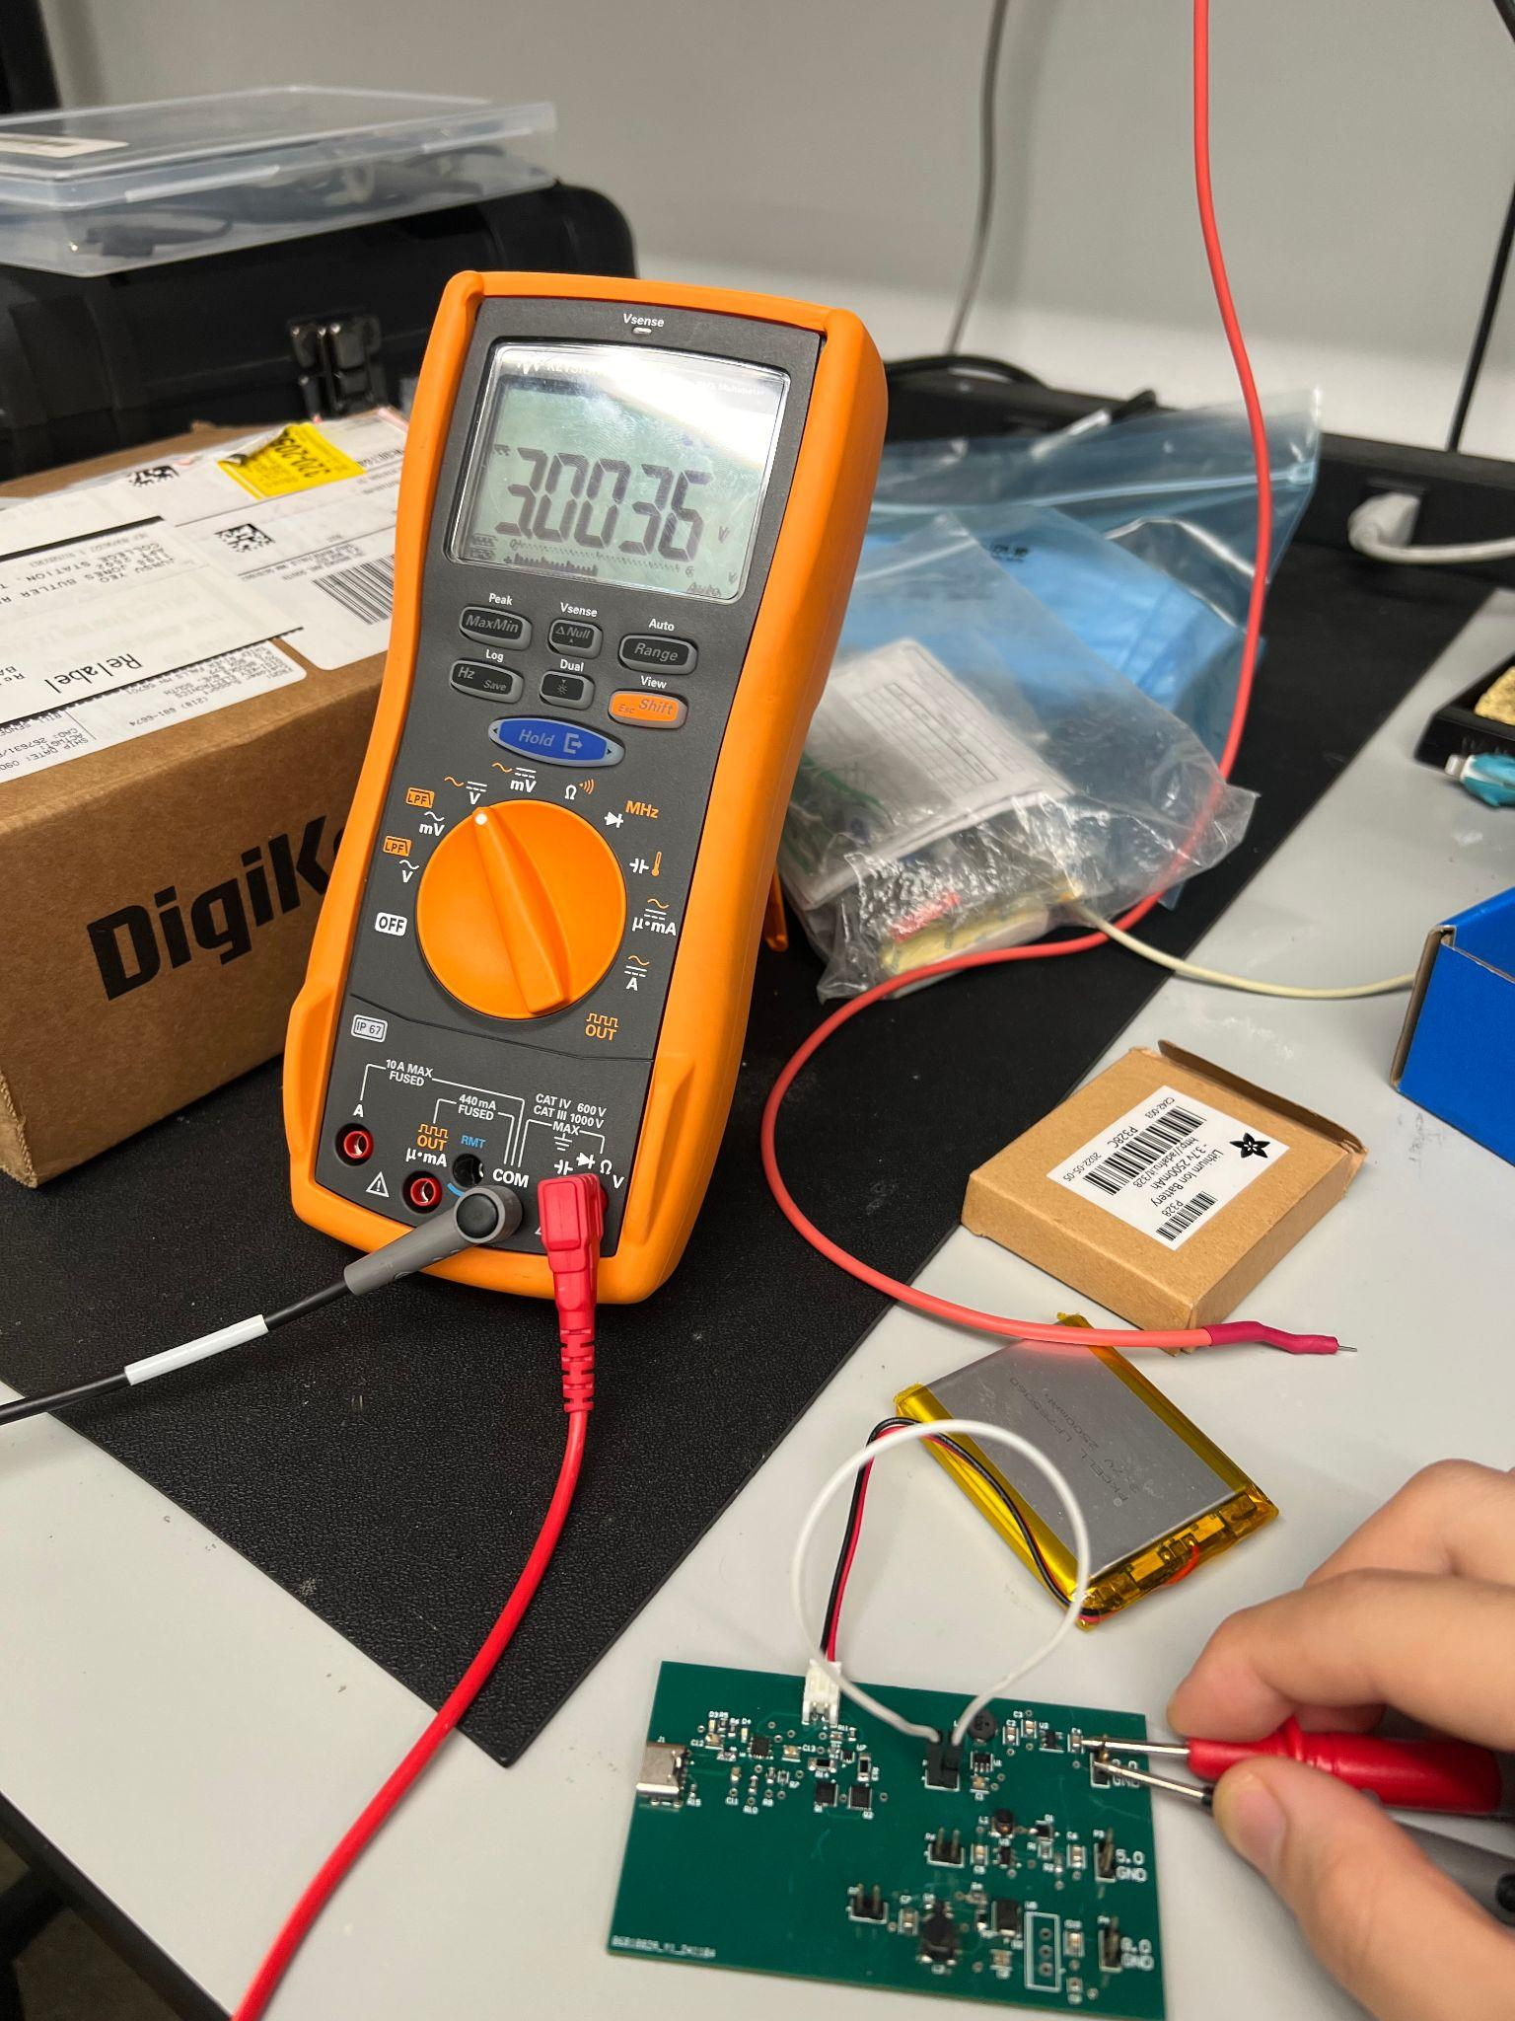
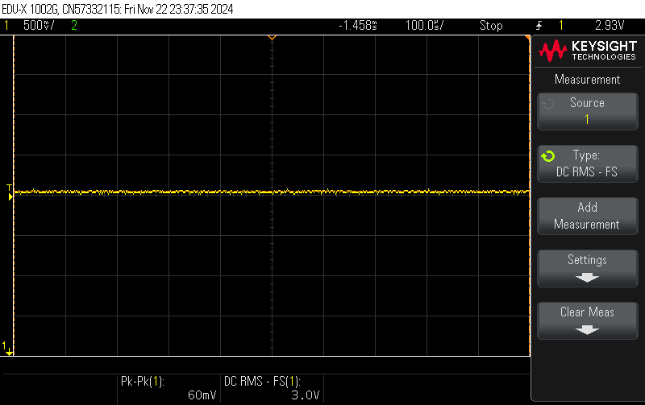
Junsu

Slide 4
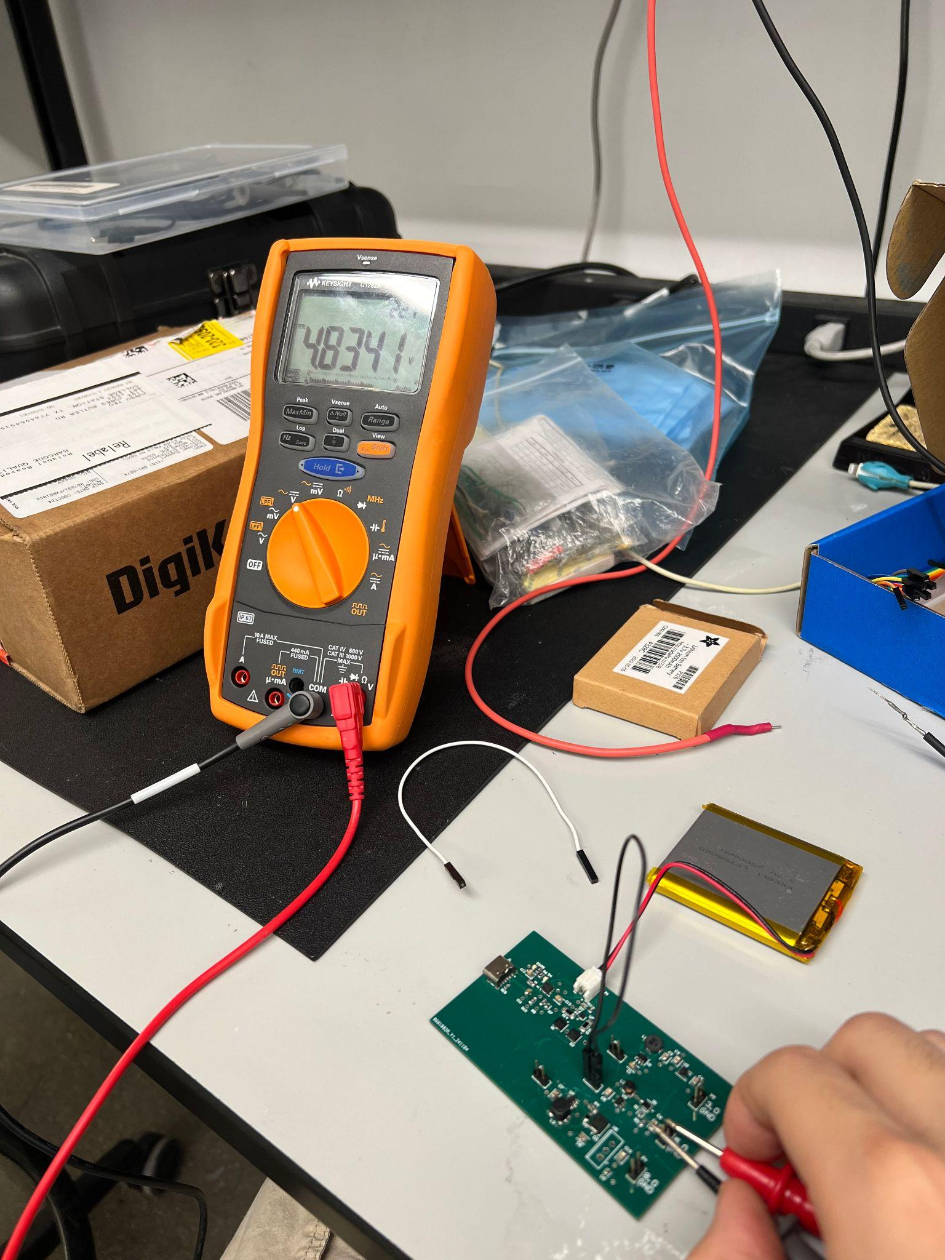
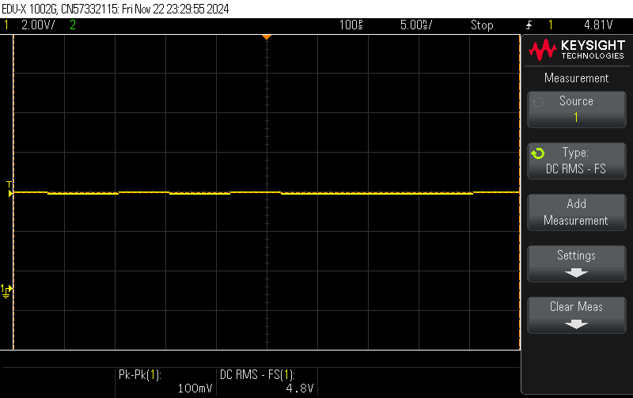

Slide 5
